Slide 1
Supply Management: Strengthening Canada’s rural economies
Stéphane Bergeron and Maurice Doyon
Egg Industry Economic Research Chaire
Université Laval

Slide 2
About this presentation
Economic benefits generated from on-farm investments in Canada
Interviews in farming communities with different proportion of supply managed farms ; 53 % 32 % 4 %

Slide 3
Study parameters
Investments considered in this study: new technologies, environmental stewardship and modernization of equipment.
Supply managed farms: eggs, milk and poultry.
Non-Supply managed farms: beef, pork, oilseeds/grains.

Slide 4
Benefits of on-farm investments
In 2015, Canadian farms invested over 9.2 billion dollars on farm improvements
Contributing
89,000 full time equivalent jobs
8.7 billion dollars to national GDP
415 million dollars of federal government fiscal revenue
508 million dollars of aggregate provincial fiscal revenue

Slide 5
"Every year, we invest. What society does not understand, is that agricultural generates enormously, it creates a flow of money [...] The producer may have a little margin down there, but the equipment, and buying used equipment, we reinvest, it's incredible [...] You know I’ll have a three hundred thousand to invest, it's money that goes directly to work nearby, like to electricians ... You know, the local economy."
Hog producer*
*Translation from French quote

Slide 6
Supply managed farms contribute more on the basis of Farm Cash Receipts
Supply managed farms represent 20 % of farm cash receipts of the
six sectors studied.
However – »
25% of on-farm investments
30% of jobs created
28% of GDP

Slide 7
The benefits of stability
These investments do not include the purchase of quota. It therefore seems that despite the additional cost associated with the supply management (quota) the stability creates a favorable environment for on-farm investment.

Slide 8
The benefits of stability
This stability makes it possible to maintain service infrastructures during periods of downward cycles of other productions not under supply management.

Slide 10
"I realize that when I was in IT, I was alone to go see the client. There were fewer suppliers. But in the dairy business, it's amazing. You have the people in the machinery that are going to pass, often the guy in the machinery will bring a seedling specialist to adjust the machinery. You have the Coop or the seed suppliers who pass. You have all the food specialists. You have the vet. You have people picking up dead animals. You have milk collection. Apart from personal things like Videotron and Bell passing. You have milking robots and all the services that follow. It's rare that I go to a producer and that I do not meet someone ... many services revolve around dairy production.”
Farm Supplier*
*Translation from french quote

Slide 12
"If we look at farms that have grown, it's millions of investments. It's good for [the municipality's] economy. They need more machinery, more equipment, it makes other businesses live in the area. When you invest a million, it is divided into different suppliers. And after you have the maintenance of all that. All the machinery to maintain. It stimulates the economy with what you invest »
Municipal authority*
*Translation from French quote

Slide 13
The impact on rural communities are significant
With rural economies existing on a smaller scale than their urban counterparts, the relative importance of one new job in rural areas carries different weight than one new job created in urban centers.
Expressing the estimated benefits for regions relative to the importance of urban centers are more meaningful to decision makers.

Slide 14
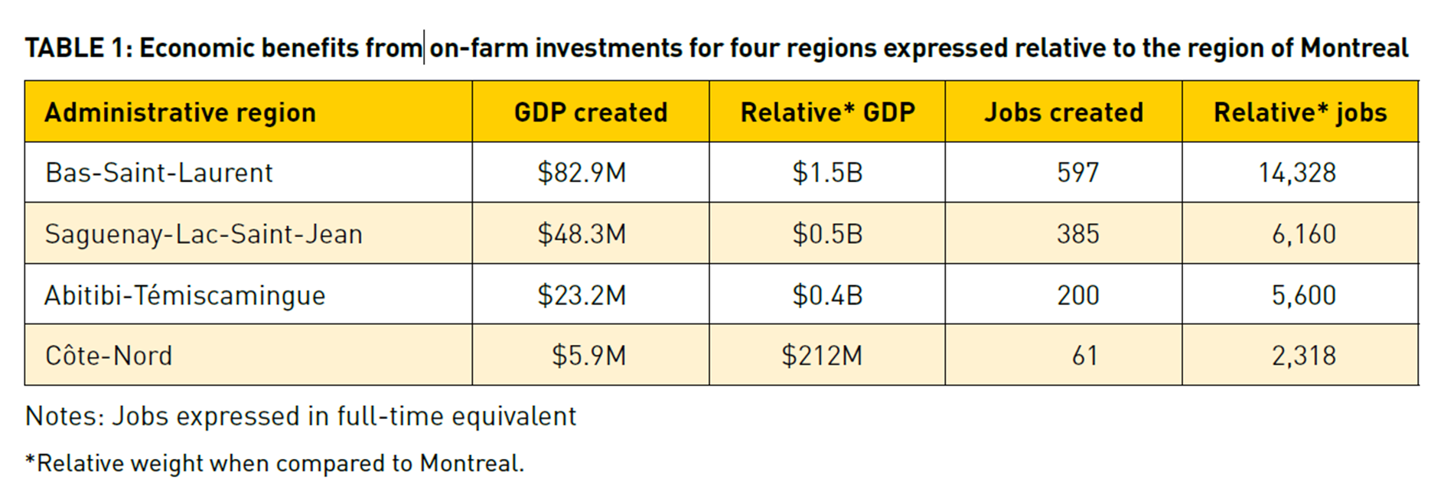
Relative contribution to rural economies

Slide 15
Conclusion
The importance of agriculture is undeniable, but this fact is often unknown to the rest of society
The stability of agricultural margins is an important for investments;
Market stability allows farmers to invest and plan long-term expansion projects.

Slide 16
Conclusion
Stability promotes investment;
Supply management allows the region to maintain economic activity even during unfavorable cycles.
Agriculture generates economic activity that is significant at regional scales.

Slide 17
Conclusion
ChaireOeufs.org
Doyon, M., & Bergeron, S. (2018). Economic Impact from farm investments in Canada 2015. Center for Interuniversity Research and Analysis on Organizations (CIRANO).
https://cirano.qc.ca/en/summaries/2018RP-12

Slide 18
Annexe

Slide 19
Annexe
Three kinds of impact:
• Direct (for example, jobs created from building new infrastructure)
• Indirect (for example, jobs created by companies hired by farms)
• Induced (for example, household spending resulting from money earned by farm workers)

Slide 20
Annexe

Slide 21
Annexe

